Slide 1
INFO1112 Tutorial
Week 3

Slide 2

Couple of reminders
Assignment 1 – due Thursday 3rd September 23:59:00 (Week 5)
Functionality of program: have a look at the os module for many functions, and other allowed modules in pinned post on Ed
Any questions, refer to Edstem if there is a question you have it is very likely another student has asked it already. If not, there may be something in the assignment specs that clarify the answer

Slide 3


Managing your time in Assignment 1
First, some general advice.
Work in short bursts – You can only work for about 4 hours at max capacity per day. Spend 1 hour working, then take a break. Do this four times, on each day that you work on the assignment.
Make a start this week - the assignment is designed to be completed over 3 weeks. You will not have time to do it all in one week.
Creating testcases throughout not only lets you catch issues in your assignment as you develop it, but also will help you understand the requirements.

Slide 4
Suggested schedule
When you first sit down:
Read the specs and draw a picture for yourself of how Jafr interacts with the filesystem. Plan your code. What functions or modules will you create? Draw pictures. (Day 1)
Week 3:
Work on setup and displaying reminders. Write tests. (Day 2)
Work on changing Jafr’s master directory. Write tests. (Day 3)
Work on completing tasks. Write tests. (Day 4)
Week 4
Work on adding meetings. Write tests. (Day 5)
Work on sharing tasks/meetings. Write tests. (Day 6)
Week 5
Work on `.bashrc`. You might be surprised how simple the solution is here, but it takes some time to understand what is required. (Day 7)
Write final tests. Try to catch bugs in your own code and fix them. (Day 7)
Notes:
The days here accumulate the hours. In the previous slide, we said they will work 4 hours per day, so the total here is 7 x 4 = 28 hours

Slide 5
Couple of reminders
Homework 1 – interviews
We will begin conducting Homework 1 interviews this week. It is worth 50% of your overall homework. Since homework is completed every two weeks, if you are not able to attend one tutorial you can arrive the following week to complete the interview.
Usually only 10 out of the 20 students are interviewed in one week.
If you know you cannot arrive for an interview in the following week, I will make sure to hold the interview today
Ensure you can:
explain functionality of programs used in script
explain functionality of flags used in script
You can look at your script while explaining

Slide 6
Brief summary of this week’s content

Slide 7

3.1 – Processes
Program: executable sequence of instructions stored on mass storage
Process: instructions of program stored in memory, and any other data required by program
Variables
Files to be kept open
From the shell, processes can be executed in parallel/in the background by adding the & symbol at the end of the program, e.g. $ echo hello &
To manage processes, Unix systems have a variety of system calls:
fork
exec
wait

Slide 8
3.1 – Processes
fork
,Creates a child process which is identical to parent process, except for:
process ID (PID)
parent process ID (set to PID of process which performed fork)
resource metadata (e.g. time running on CPU), which is reset
Initially, parent and child process share same files
Once forked, both programs continue from the point of the fork system call
Parent: fork returns PID of child
Child: fork returns 0

Slide 9
3.1 – Processes
exec
Used to completely replace the currently running process with a different program specified
wait
Suspends execution of current process until one of its child processes exits
If child exits but parent has not called wait, child becomes a zombie process until wait is called
Stays in the process table once exited

Slide 10
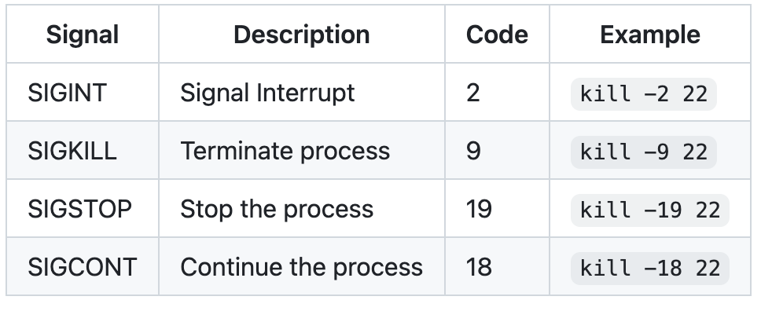
3.1 Processes
kill
A misleading name, just means to send a signal to a process
Kill is extremely important for managing processes
Syntax: kill <flag> <pid>

Slide 11
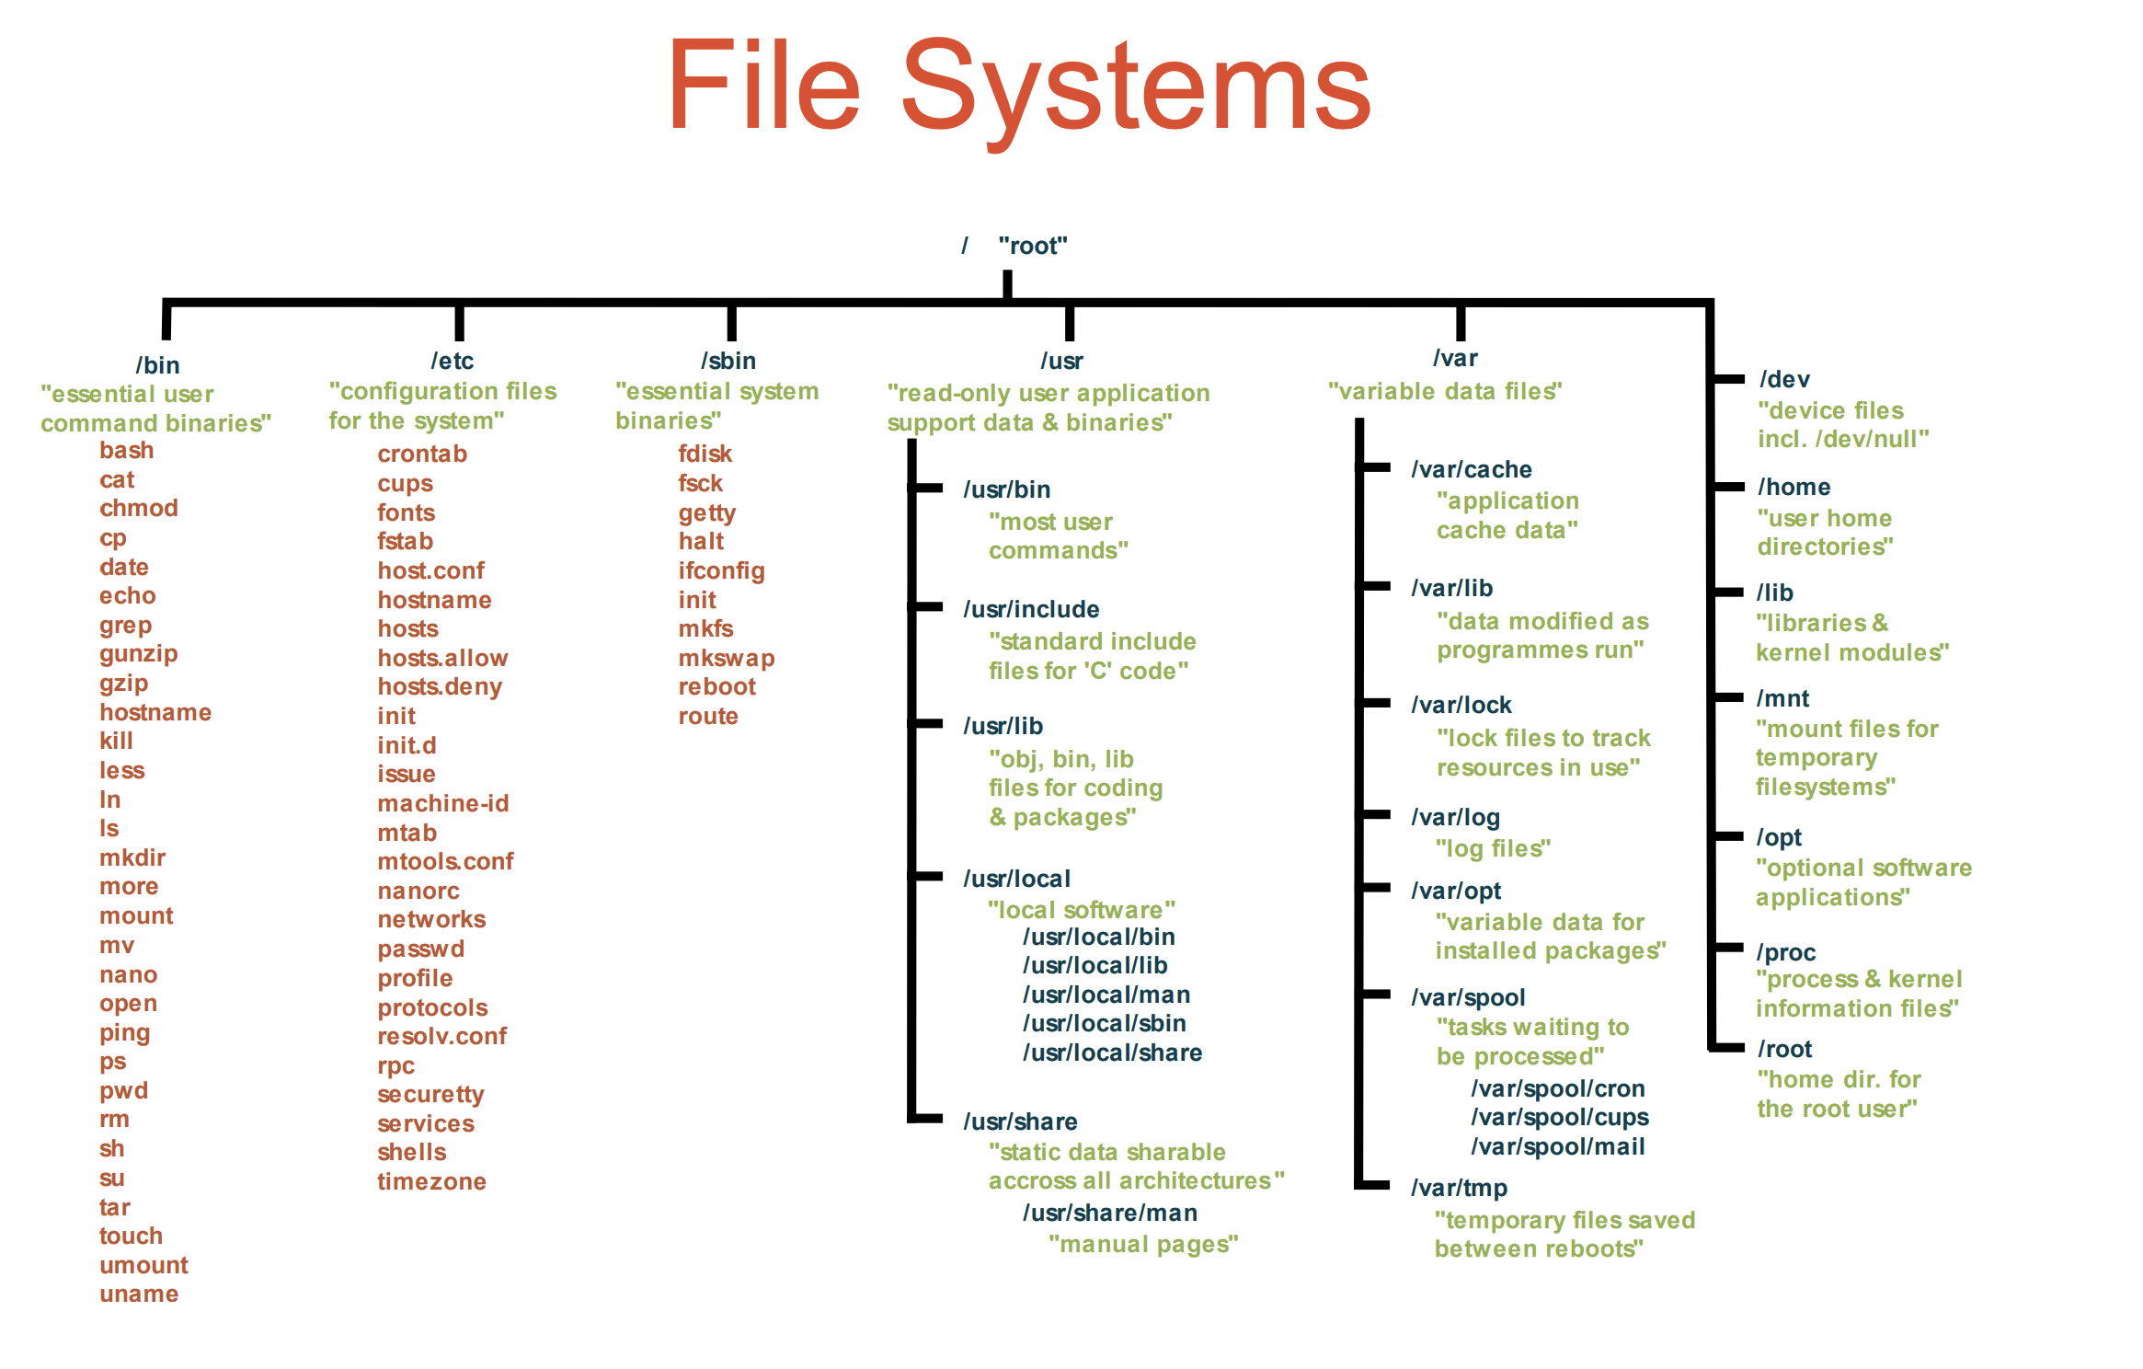
3.2 – File Systems
A file system describes a way to lay out/represent file data on mass storage
Operating systems have file system module, which provides an interface to the namespace to interact with files from mass storage, or other devices
File systems can also “mount” ‘files’ which display information about the system
Example: /proc directory on Linux

Slide 12
3.2 – File Systems
To access a file system via the namespace, you can use the mount system call on Unix systems
The mount command also allows you to mount file systems, and display file systems mounted to your device (example below)
/dev/disk3s1s1 on / (apfs, sealed, local, read-only, journaled)
devfs on /dev (devfs, local, nobrowse)
/dev/disk3s6 on /System/Volumes/VM (apfs, local, noexec, journaled, noatime, nobrowse)
/dev/disk3s2 on /System/Volumes/Preboot (apfs, local, journaled, nobrowse)
/dev/disk3s4 on /System/Volumes/Update (apfs, local, journaled, nobrowse)
/dev/disk1s2 on /System/Volumes/xarts (apfs, local, noexec, journaled, noatime, nobrowse)
/dev/disk1s1 on /System/Volumes/iSCPreboot (apfs, local, journaled, nobrowse)
/dev/disk1s3 on /System/Volumes/Hardware (apfs, local, journaled, nobrowse)
/dev/disk3s5 on /System/Volumes/Data (apfs, local, journaled, nobrowse, protect)
map auto_home on /System/Volumes/Data/home (autofs, automounted, nobrowse)
Mass storage device containing file system
Where it is being mounted
Type of filesystem
Parameters

Slide 13
Shell if Statement
Used to test condition
Similar to if statement in other programming languages
Action can be performed if statement is true
Also supports elif and else
Syntax:
if [ condition ]
then
Do something
elif [ condition ]
then
Do something else
else
Do something different
fi

Slide 14

Attendance
https://bit.ly/3Kpf2ws

Slide 15
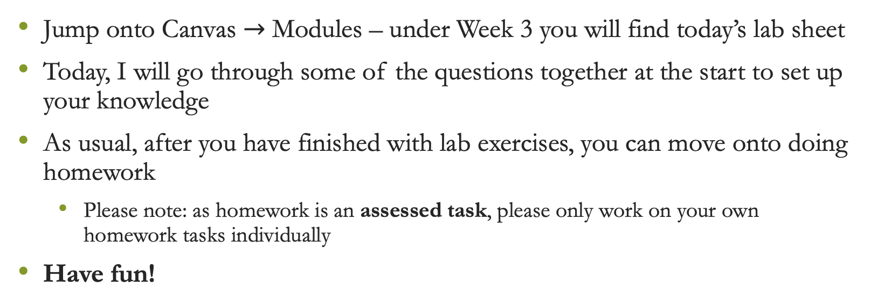
Lab exercises
Jump onto Canvas $→$ Modules – under Week 3 you will find today’s lab sheet
Today, I will go through some of the questions together at the start to set up your knowledge
As usual, after you have finished with lab exercises, you can move onto doing homework
Please note: as homework is an assessed task, please only work on your own homework tasks individually
Have fun!

